Slide 1
WELCOME To DIY GURU BATTERIES

Slide 2
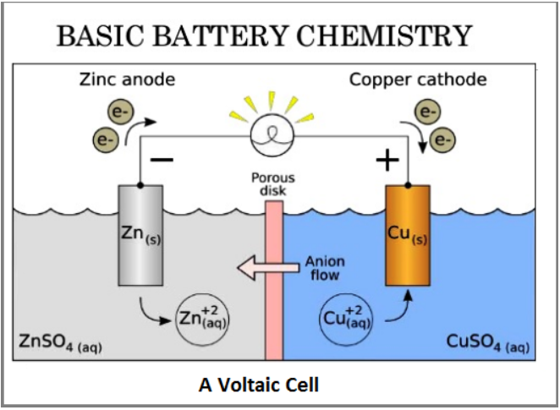
What is a battery ?
• A battery consists of two or more electric cells joined together.
• The cells convert chemical energy to electrical energy.
• The cells consist of positive and negative electrodes joined by an electrolyte.
• It is the chemical reaction between the electrodes and the electrolvte

Slide 3
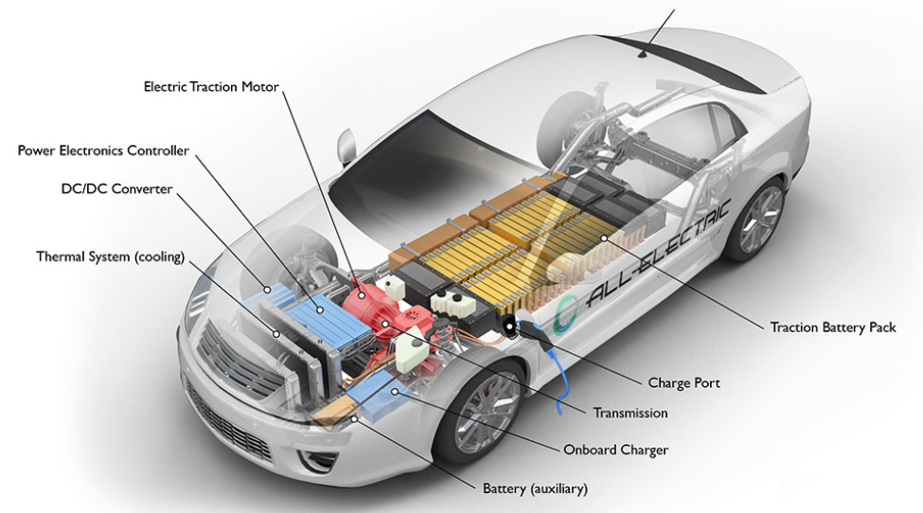
Role of battery in electric vehicles
• We know that there are many different types and sizes of electric vehicle However, in nearly all cases the battery is a key component. In the classic electrical vehicle the battery is the only energy store, and the component with the highest cost, weight and volume.

Slide 4
Two Kinds of batteries
Non-Rechargeable
(Disposal)
Rechargeable

Slide 5
What are rechargeable batteries
• A rechargeable battery, storage battery, secondary cell, or accumulator is a type of electrical battery which can be charged, discharged into a load, and recharged many times, as opposed to a disposable or, Primary battery, which is supplied fully charged and discarded after use. It is composed of one or more electrochemical cells.
• In the case of secondary or rechargeable batteries, the chemical reaction can be reversed by reversing the current and the battery returned to a charged state.

Slide 6
Non - Rechargeable
• In the case of non-rechargeable batteries, the chemical reaction cannot be reversed once after its reaction.
• So these kind of batteries are useful for one time use.

Slide 7






Non - Rechargeable
TV REMOTE BATTERY
WATCH BATTERIES
TOY BATTERIES
Rechargeable
Phone battery
Invertor Battery
Laptop Battery

Slide 8
How to select batteries ? To your vehicle How to judge a battery?

Slide 9
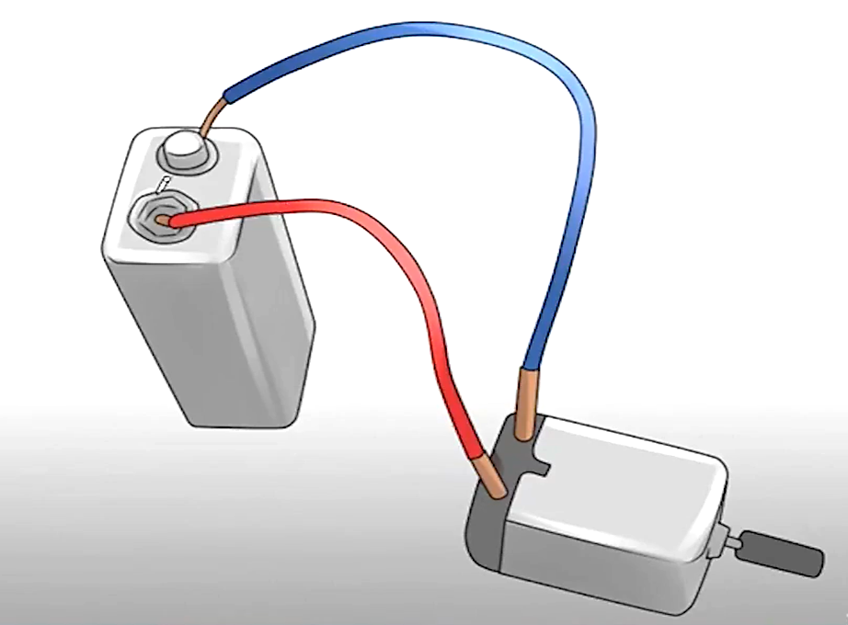

Slide 10
Parameters to select a battery to your vehicle
Battery voltage
Battery Capacity
Energy Stored
Specific Energy
Efficiency
Energy Efficiency
Self- Discharge Rates
Battery Temperature, Heating and cooling needs
Battery Life and Number of Deep Cycles.

Slide 11
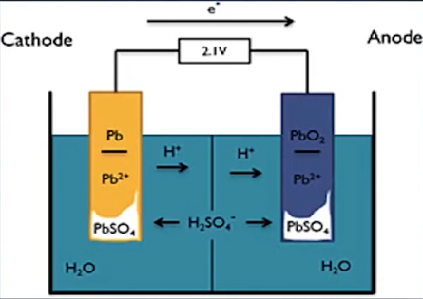
Battery voltage
Voltage is the electromotive force or the electric potential energy difference between two points (often within the context of an electrical circuit) per unit of charge, expressed in volts (V). Voltage, along with current and resistance, is used to describe the behaviour of electrons. The relationships are observed through the application of Ohms law and Kirchhoffs circuit laws.

Slide 12
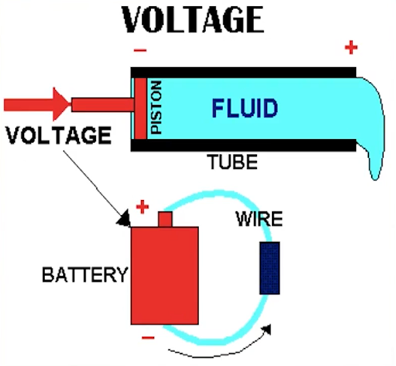
Difference Between voltage and current
• Current :- The current is a flow of electrons per unit time.
Let us consider an example, you are having a piston and a pipe. Consider there is a fluid in a pipe and piston helps you to push that fluid.
• Now Assume here
Fluid = Electrons,
Force used to push the piston to push fluid =
Voltage
• Now in a layman language, Voltage is a forceused to push the electrons and moment of that electrons create electric charge or current.

Slide 13
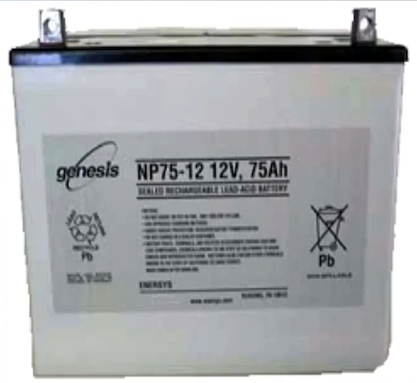
(AMP HOUR) Capacity
• Capacity of a battery can
be determined as
If a Load draws " I Ampere" current from the
battery for continuously one hour, then it is said to
be " IAmp Hour "

Slide 14
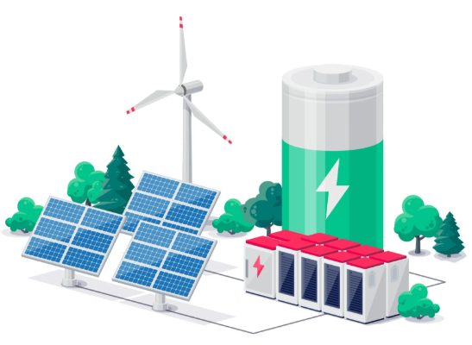
Energy Storage
• The purpose of the battery is to store energy. The energy stored in a battery depends on its voltage, and the charge stored.
• The SI unit is the Joule, but this is an inconveniently small unit, and so we use the Watthour instead.
• This is the energy equivalent of working at a power of I Watt for 1hour. The Watthour is equivalent to 3600 Joules.
• The Watthour is compatible with our use of the Amphour for charge, as
it yields the simple formula:
• Energy in Watthours = Voltage x Amphours or Energy = V x C

Slide 15
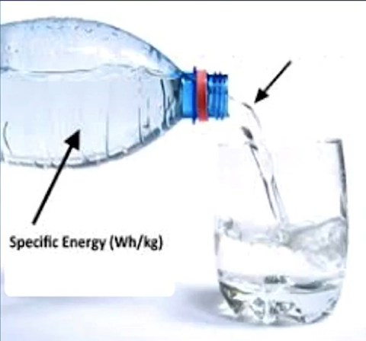
Specific Energy
Specific energy is the amount of electrical energy stored for every kilogram of battery It has units of Wh.kg - l. Once the energy capacity of the battery needed in a vehicle is known (Wh) it can be divided by the specific energy (Wh.kg - l) to give a first approximation of the battery mass. Specific energies quoted can be no more than a guide, because as we have seen, the energy stored in a battery varies considerably with factors such as temperature and discharge rate.

Slide 16
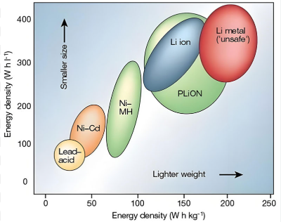
Energy density
Energy density is the amount of electrical energy stored per cubic metre of battery volume. It normally has units of Wh.m—3. It is also an important parameter as the energy capacity of the battery (Wh) can be divided by the battery's energy density (Wh.m—3) to show the volume of battery required. Alternatively if a known volume is available for batteries, the volume (m3) can be multiplied by the batteries energy density (Wh.m—3) to give a first approximation of how much electrical energy can be made available. The battery volume may well have a considerable impact on vehicle design. As with specific energy, the energy density is a nominal figure.

Slide 17
Energy efficiency
This is another very important parameter and it is defined as the ratio of electrical energy supplied by a battery to the amount of electrical energy required to return it to the state before discharge. A strong argument for using electric vehicles is based on its efficient use of energy, with resulting reduction of overall emissions; hence high energy efficiency is desirable. It should be clear from what has been said in the preceding sections that the energy efficiency will vary greatly with how a battery is used. If the battery is charged and discharged rapidly, for example, energy efficiency decreases considerably. However it does act as a guide for comparing batteries, in much the same way as fuel consumption does for cars
• Consider an example of 5 year old battery
Energy Efficiency = (Energy during discharging I Total Energy consumed by charging)

Slide 18
Self discharge rates
• Most batteries discharge when left unused, and this is
known as self-discharge. This • Battery gradually Looses its charge during is important as it means some
periods of disuse. batteries cannot be left for
long periods without recharging. The reasons for
this self-discharge will be explained in the sections that follow. The rate varies with battery type, and with other factors such as temperature;
higher temperatures greatly increase self-discharge
Battery gradually looses its charge during periods of disuse.
Self Discharge Rate depends on temperature.
> Rate doubles for every 18-degree Fahrenheit.
Flooded Cell Batteries will lose approximately
> 25% of its charge for every 30 days at 770 F.
> 25% of its charge for every 15 days at 950 F.
> 25% of its charge for every 07 days at 1130 F.

Slide 19
Battery temperate, heating and cooling needs
• Although most batteries run at ambient temperature, some run at higher temperatures and need heating to start with and then cooling when in use.
• In others, battery performance drops off at low temperatures, which is undesirable, but this problem could be overcome by heating the battery.
• When choosing a battery the designer needs to be aware of battery temperature, heating and cooling needs, and has to take these into consideration during the vehicle design process.

Slide 20
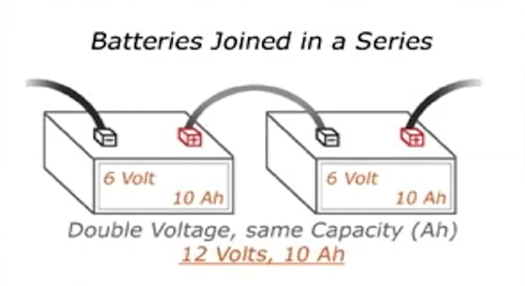
Basic Knowledge on Batteries
• Question- Let us suppose, I have a requirement for a battery of 12 volts and went to a battery shop where he is having at voltage of '6 V'. then what should I do.
• Answer:- Get a two Lead acid batteries and make it in series.
CONCEPT USED -SERIES CONNECTION IN Battery

Slide 21
Basic Knowledge on batteries
• Question 2- Let us suppose, I have a requirement for a battery of 12 Volts, 20Ah and went to a battery shop where he is having at voltage of '6 V', 10 Ah.
then what should I do.
• Answer:- Get a two Lead acid batteries and make it in parallel.
CONCEPT USED - SERIES AND PARLLEL cONNECTION
6V
6V
6V
6V
10AH
10AH
10AH
10AH

Slide 22
Basic Knowledge on batteries
• Question 2- Let us suppose, I have a requirement for a battery of 12 Volts, 20Ah and went to a battery shop where he is having at voltage of '6 V', 10 Ah.
then what should I do.
CONCEPT USED - SERIES AND PARLLEL cONNECTION
• Answer:- Get a two Lead acid batteries and make it in parallel.
6V
6V
6V
6V
10AH
10AH
10AH
10AH
12 V
12 V

